Slide 1
INTRODUCCION TO ROBOTICS.
Group B2
Member:
Cristhyan Ojeda
Mariano Ovelar
Juan Farina
Professor: Shuhao Liang.
T.A. Marnel Altius

Slide 2
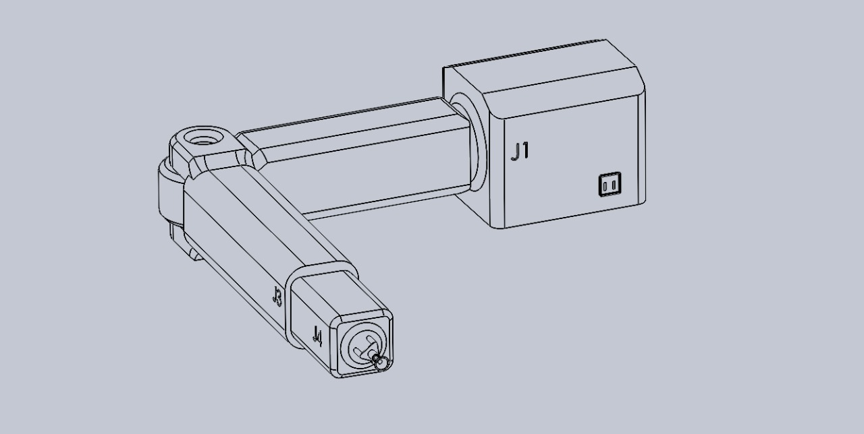
Why We Designs this robot?
The BATT-BOT was designed to be an affordable solution for industrial automation, especially for small and medium-sized businesses looking to streamline their processes without incurring the high costs of traditional industrial robots.
Reasons for Low Cost:
Simplified Design:
Use of Economical Components:
Ease of Maintenance:
Energy Efficiency:
Benefit for Industry

Slide 3
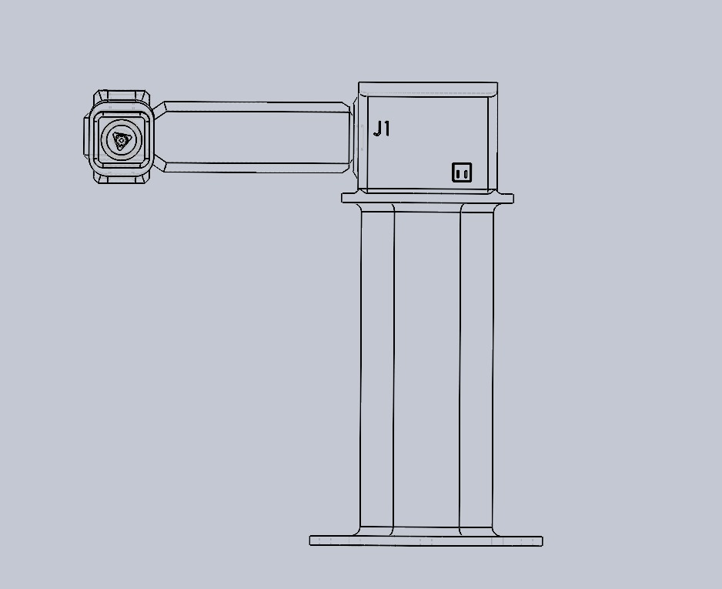
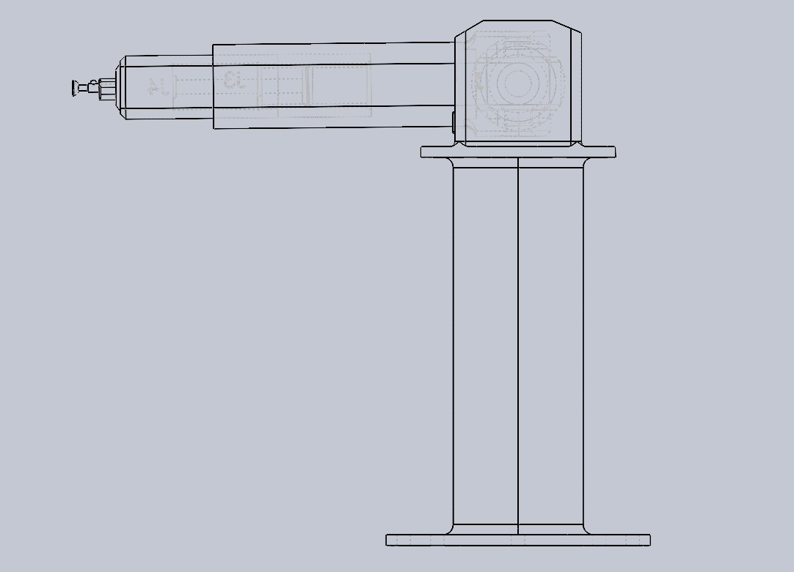
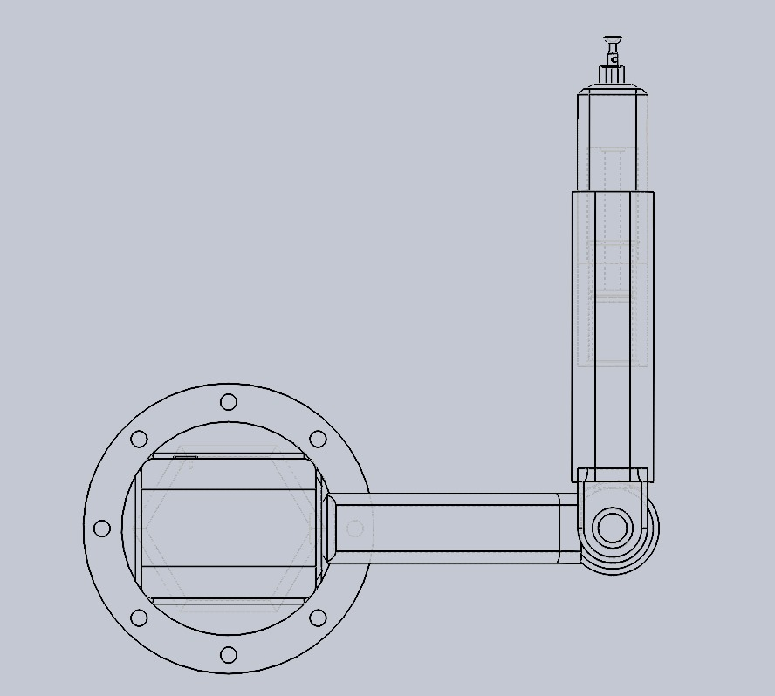
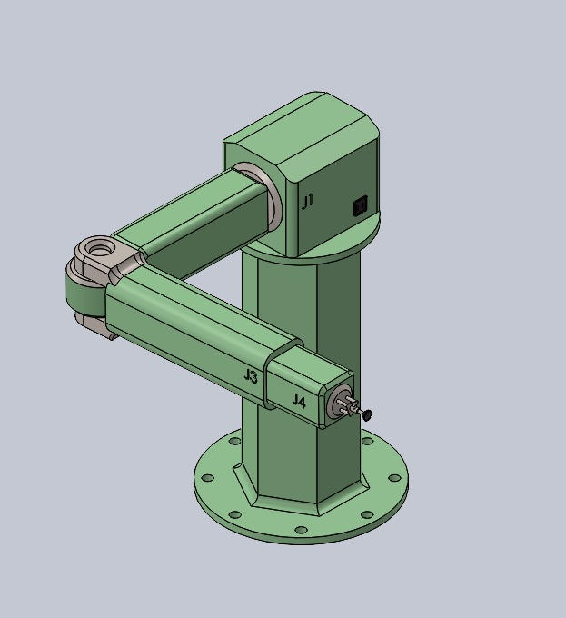
Schematic designs
Front view
Side view
Top view
Isometric view

Slide 4
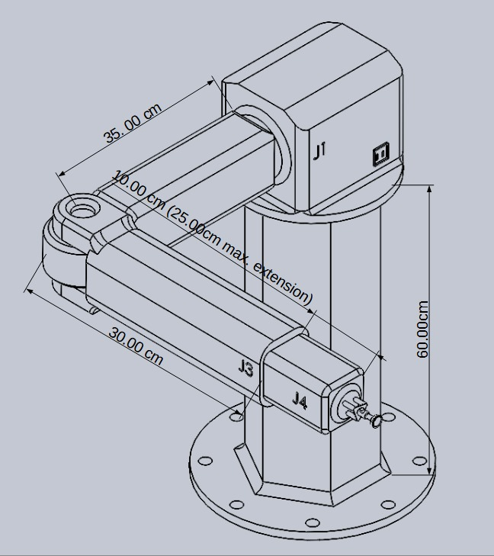
Isometric and Dimensions view

Slide 5
Mathematical Model of the Robot
The mathematical model of a robotic arm consists of two main components:
Kinematics
Dynamics
1. Kinematics
1.1. Denavit-Hartenberg (DH) Parameters
Using the DH convention,
Link | θ (rad) | d (mm) | a (mm) | α (rad) | Joint Type
1 | 0 | 0 | 35 | 0 | Rotational
2 | 0 | 0 | 40 | 0 | Rotational
3 | 0 | 0 | 0 | 0 | Prismatic
4 | 0 | 0 | 15 | 0 | Rotational

Slide 6
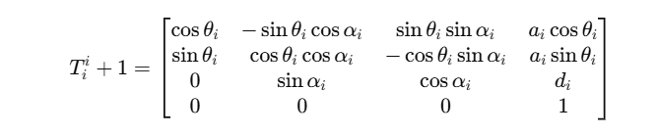
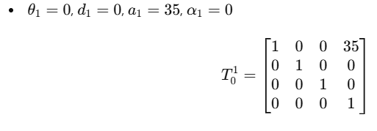
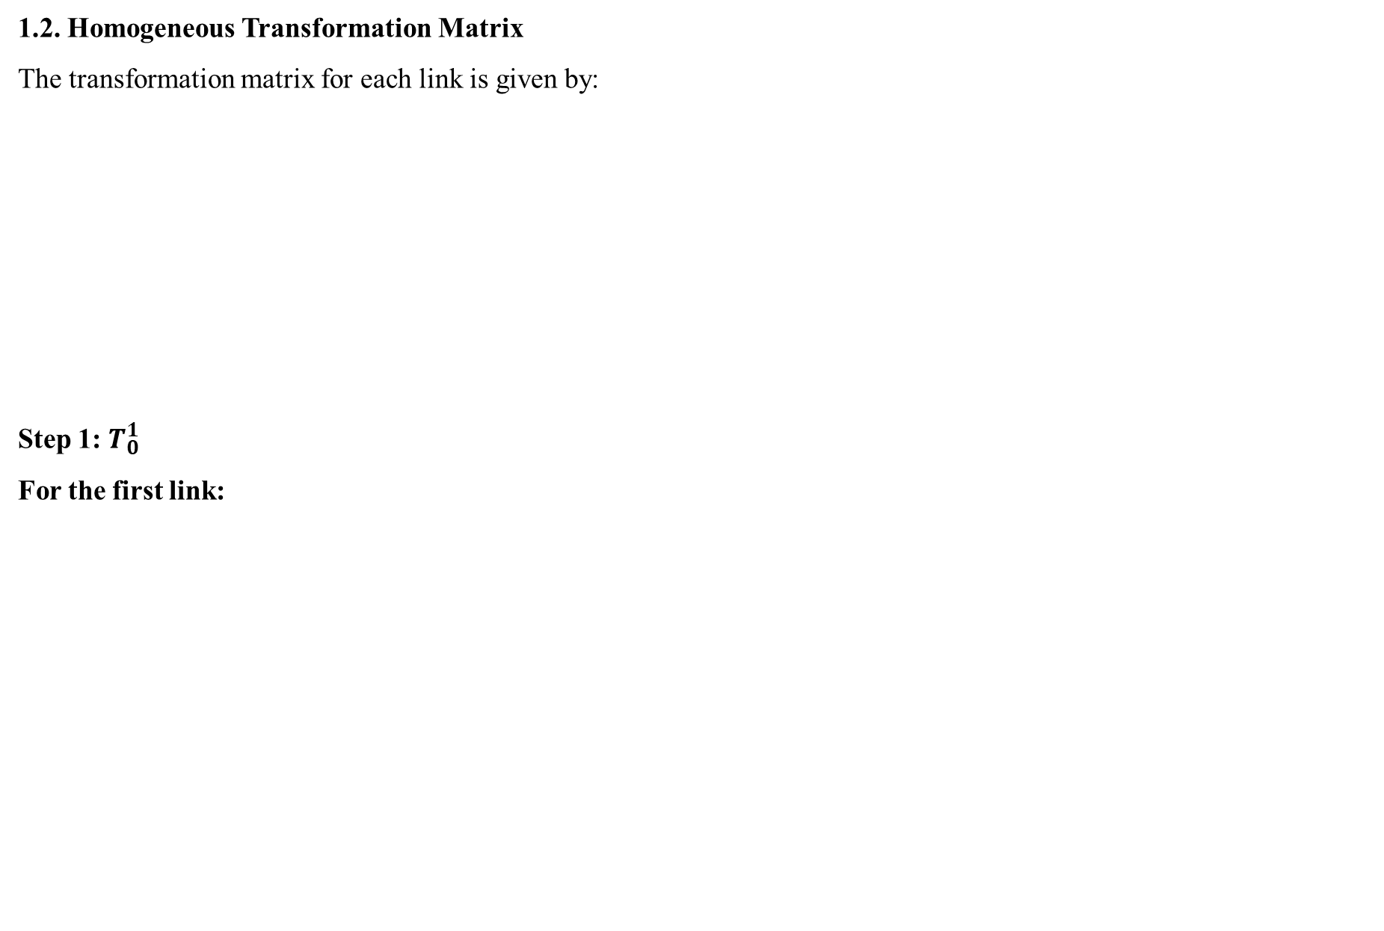
1.2. Homogeneous Transformation Matrix
The transformation matrix for each link is given by:
Step 1: $T_{0}^{1}$
For the first link:

Slide 7
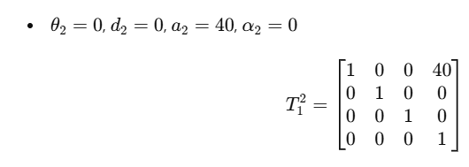
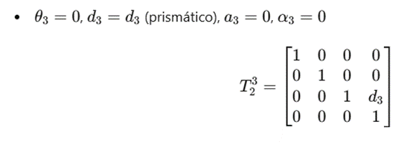
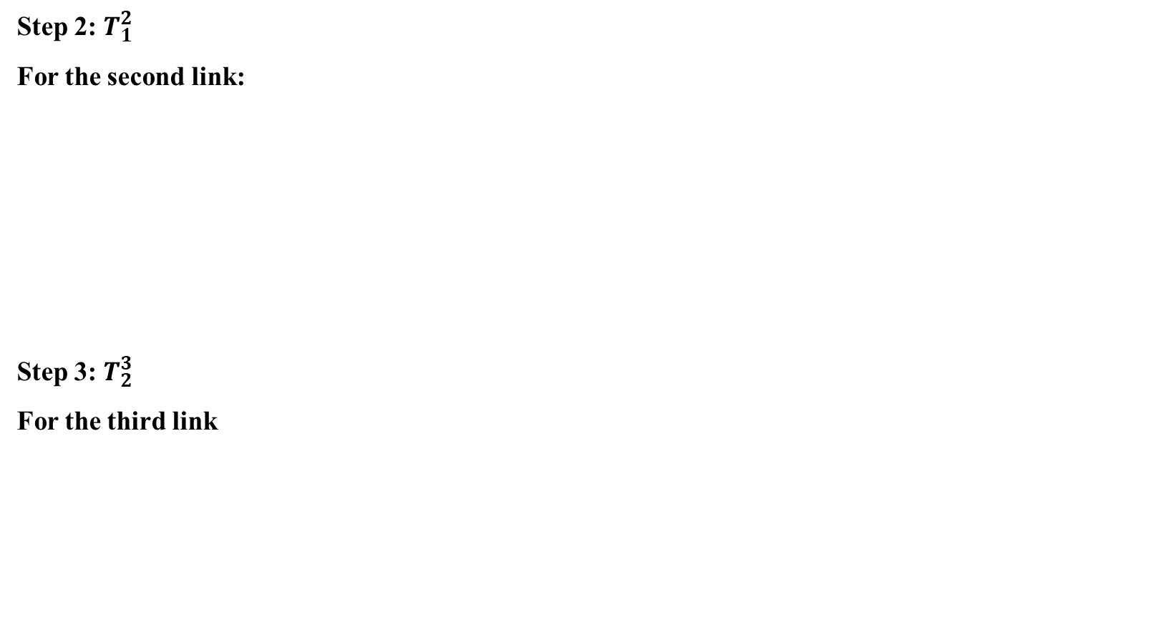
Step 2: $T_{1}^{2}$
For the second link:
Step 3: $T_{2}^{3}$
For the third link

Slide 8
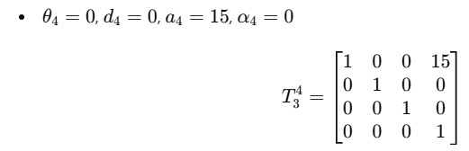
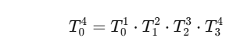
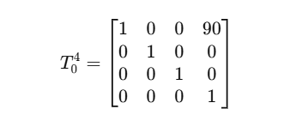
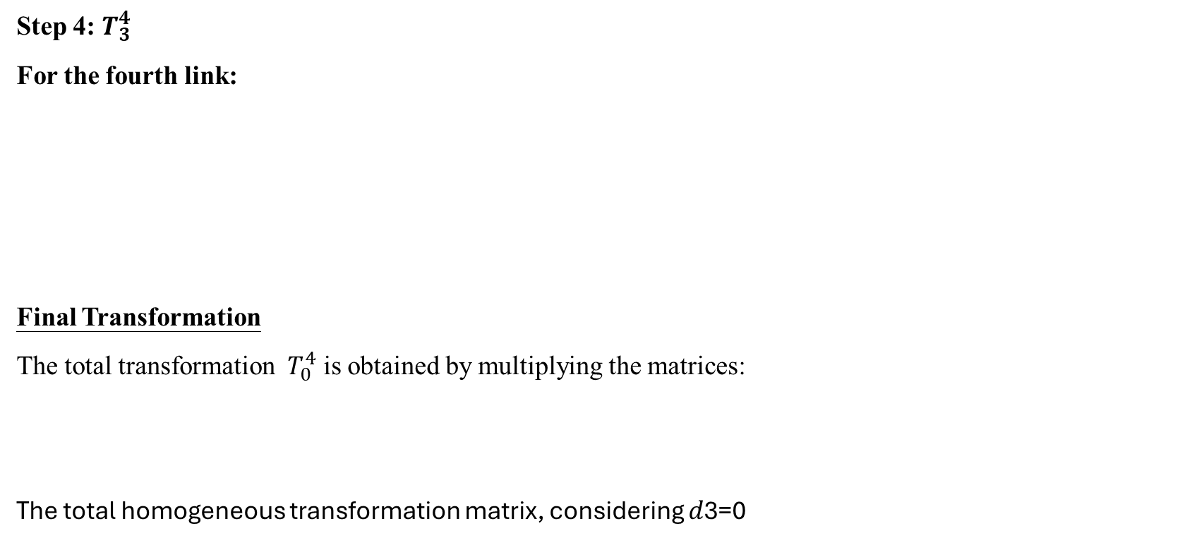
Step 4: $T_{3}^{4}$
For the fourth link:
Final Transformation
The total transformation $T_{0}^{4}$ is obtained by multiplying the matrices:
The total homogeneous transformation matrix, considering 𝑑3=0
This means that the final position is at 𝑥 = 90 mm, y = 0, z = 0 in space, relative to the base coordinate system.

Slide 9
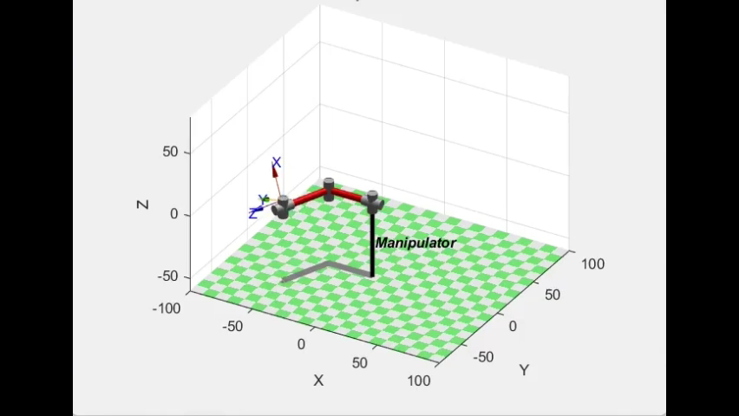
Simulation of BATT-BOT

Slide 10
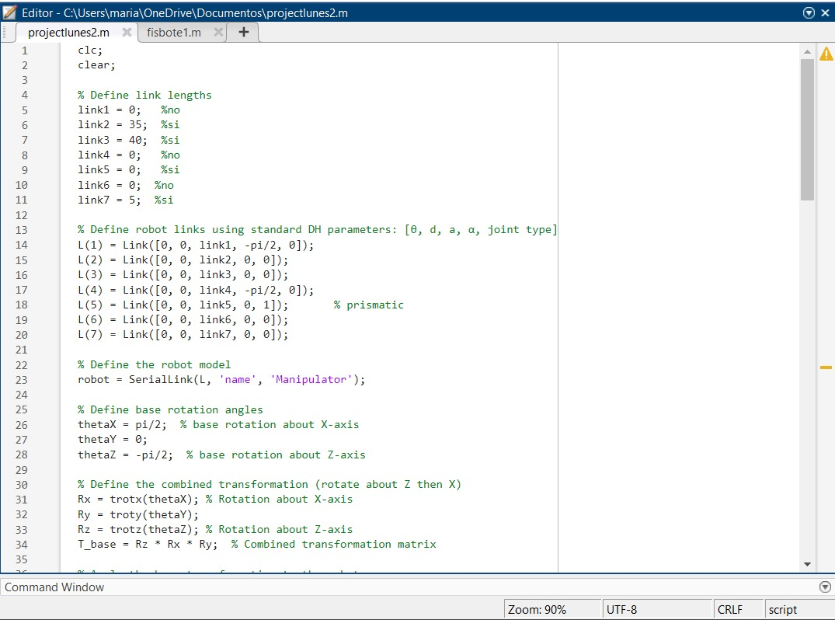
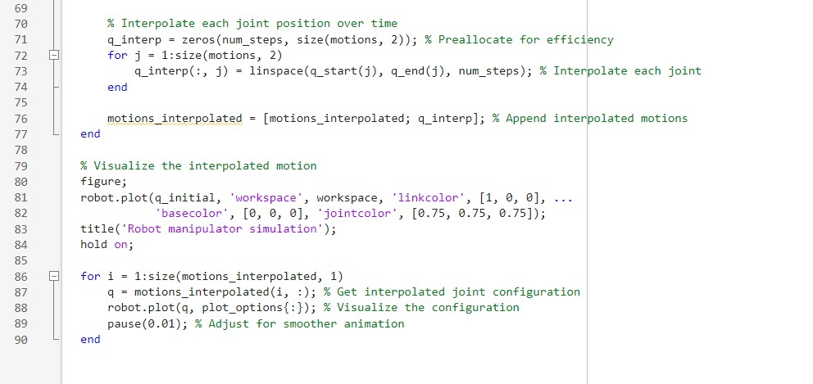

Slide 11
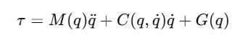
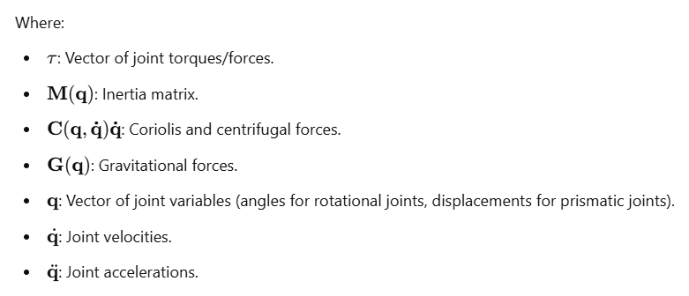
Dynamics
The dynamics of the robot describe how forces and torques are generated in response to desired motion, considering the robot's physical properties. These dynamics are typically represented using the Euler-Lagrange equation:

Slide 12
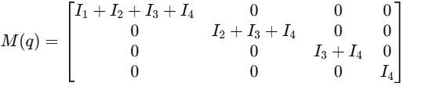
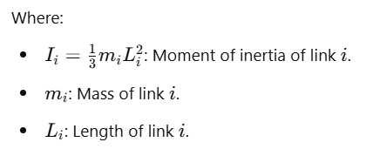
2.1. Inertia Matrix M(q)
The inertia matrix represents how the masses of the links affect the robot's movement:

Slide 13
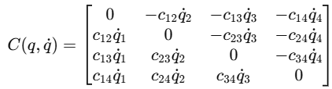
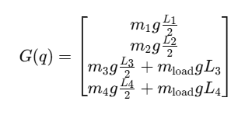
2.2. Coriolis Matrix C (q, q˙)
The Coriolis matrix contains terms that account for interactions between joint velocities:
The coefficients c_{ij} depend on the robot's configuration and physical properties.
2.3. Gravitational Terms G(q)
The gravitational vector represents the torques needed to counteract gravity:

Slide 14
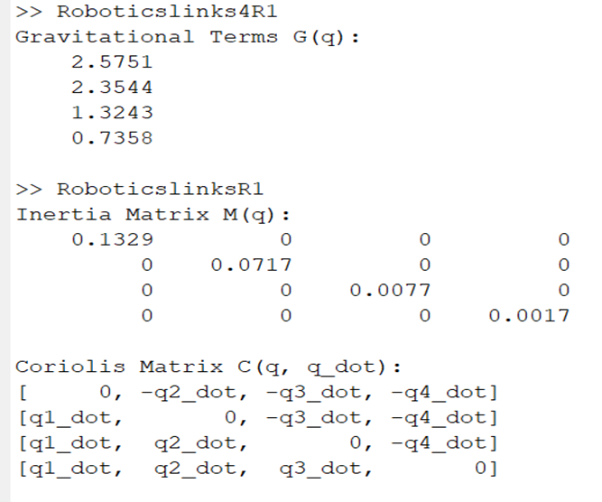
These dynamic equations form the foundation for calculating the forces and torques needed to move the robot accurately and efficiently

Slide 15
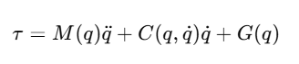
Summary of the Mathematical Model
Forward Kinematics:
• The end-effector's position is expressed as (x, y, z) in terms of the joint angles.
Dynamic Equation:
Where:
M(q) Inertia matriz.
C (q, q˙) Coriolis terms.
G(q): Gravitational terms

Slide 16
Robot Features
Parameter | Value
Length of Link 1 | L₁​=35cm (0.35 m)
Length of Link 2 | L₂=40cm (0.40 m)
Length of Link 3 | L₃=15cm (0.15 m)
Mass of Robot Body | m=1.5kg (link 1)
 | m=1.2kg (link 2)
 | m=0.8kg (link 3)
Mass of the Load | m_{load}=0.5kg
Maximum Angular Acceleration | α=1rad/s
Maximum Angular Velocity | ω=1.77rad/s
Gravitational Force | g=9.81m/s2
Maximum Torque | Calculated for each joint
Maximum Required Power | Calculated for each joint

Slide 17
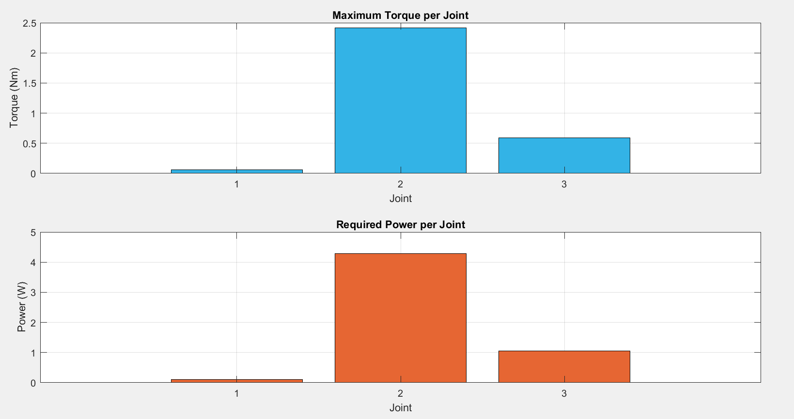
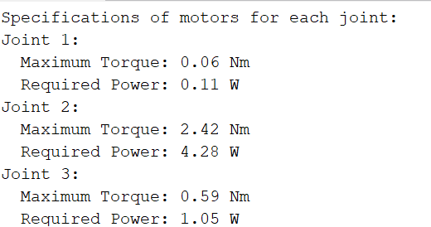
Calculate Torque and Power for each joint

Slide 18
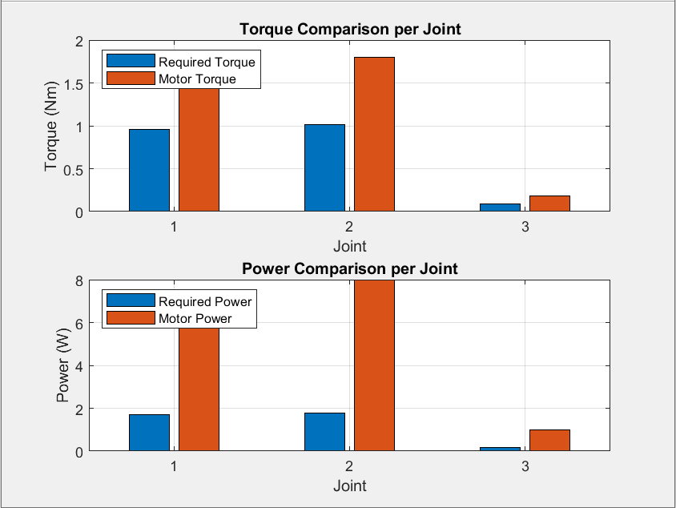
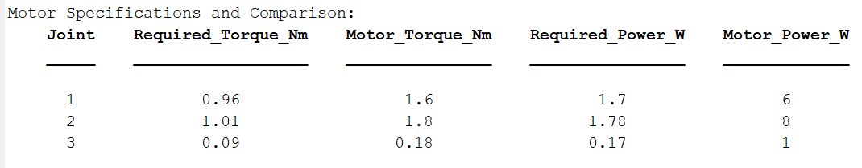

Slide 19
Motor Specifications
JOINT 1 Required torque: τ₁ = 0.96 Nm Required power: P₁ = 1.70 W Recommendation: Motor: Pololu 37D DC Gearmotor 19:1 Continuous torque: 1.6 Nm (sufficient for safety factor). No-load speed: 320 rpm (33.5 rad/s, easily adjustable with PWM control). Power: 6 W | JOINT 2 Required torque: τ₂=1.01 Nm Required power: P₂=1.78 W Recommendation: Motor: NEMA 17 Stepper Motor (with 5:1 gearbox) Continuous torque: 1.8 Nm (sufficient with margin). Speed: Supports 1.77 rad/s when using a suitable controller. Power: 8 W (more than enough). | JOINT 3 Torque required: τ₃ = 0.09 Power required: P₃ = 0.17 W Recommendation: Motor: MG90S Servo Motor Continuous torque: 0.18 Nm (twice the required torque). Speed: 0.1 s/60° (equivalent to 10 rad/s). Power: 1 W (well above the requirement).

Slide 20
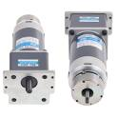
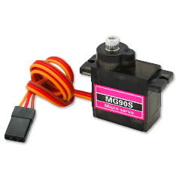
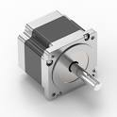
JOINT 3
JOINT 1
JOINT 2

Slide 21
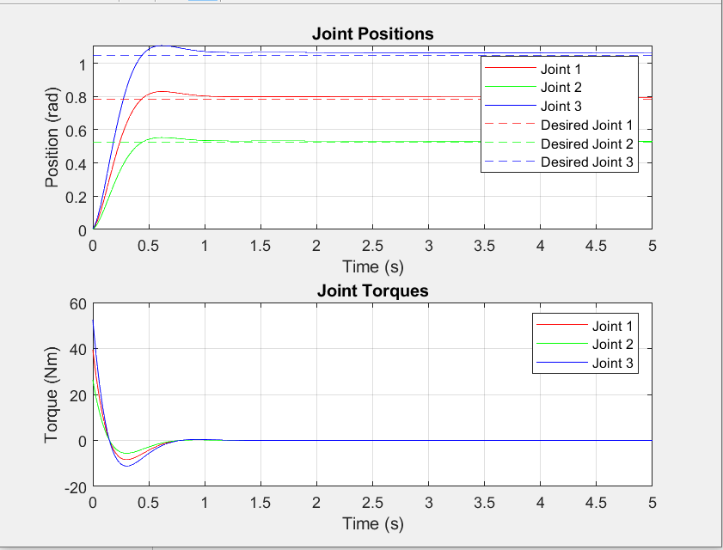
PID controller
The high initial torques compensate for the large initial error, while the system response is smoothed by the derivative action.
These graphs validate the PID controller as an effective solution for position control in robotic manipulators.

Slide 22
Model of BATT-BOT SERIES (S M L)
1. BATT-BOT S (Small) Application: Ideal for ultra-compact assembly tasks, focusing on small and lightweight components. Specifications: Link Dimensions: L1: 25 cm (0.25 m) L2: 30 cm (0.30 m) L3: 10 cm (0.10 m) Horizontal Reach: 65 cm (0.65 m). Maximum Payload: 0.3 kg. Accuracy (Repeatability): ±0.05 mm. Maximum Angular Speed ​​(ω): 1.5 rad/s. Total Robot Weight: 4 kg. Power Required: <80 W. Applications: Assembly of small batteries, connectors, and lightweight electronic components. | 2. BATT-BOT M (Medium) Application: Designed for standard production lines, handling assembly tasks with extended reach and medium payloads. Specifications: Link Dimensions: L1: 35 cm (0.35 m) L2: 40 cm (0.40 m) L3: 15 cm (0.15 m) Horizontal Reach: 90 cm (0.90 m). Maximum Payload: 0.5 kg. Accuracy (Repeatability): ±0.03 mm. Maximum Angular Speed ​​(ω): 1.77 rad/s. Total Robot Weight: 6.5 kg. Power Required: <100 W. Applications: Standard battery assembly, handling cells and small electronic device modules. | 3. BATT-BOT L (Large) Application: Optimized for assembly on larger production lines, with greater reach and payload capacity. Specifications: Link Dimensions: L1: 50 cm (0.50 m) L2: 60 cm (0.60 m) L3: 20 cm (0.20 m) Horizontal Reach: 130 cm (1.30 m). Maximum Payload: 1.0 kg. Accuracy (Repeatability): ±0.02 mm. Maximum Angular Speed ​​(ω): 2.0 rad/s. Total Robot Weight: 10 kg. Power Required: <150 W. Applications: Assembly of large modules, assembly on more demanding lines, handling of heavier cells.

Slide 23
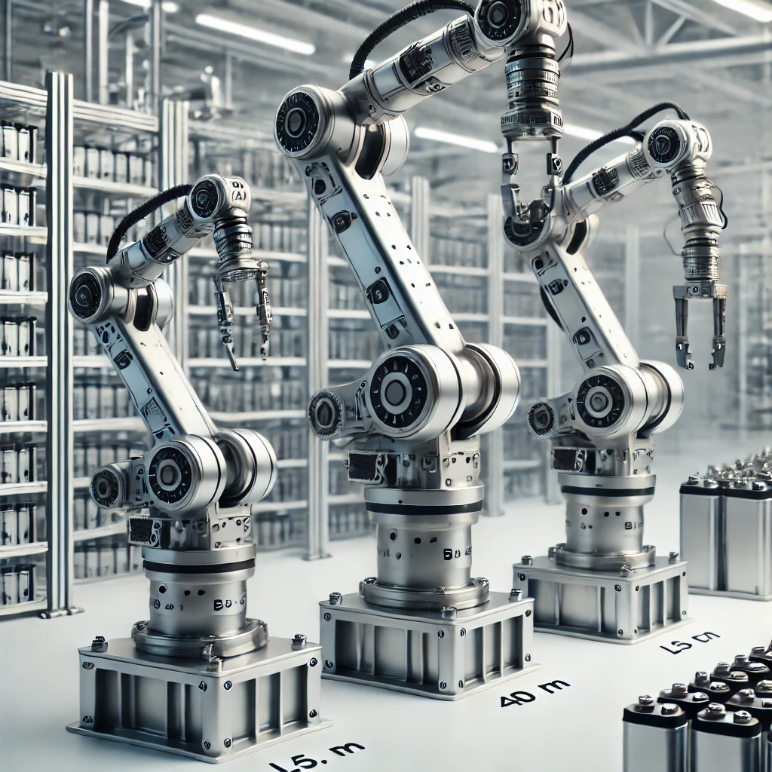
Illustrative photo
Comparison in Table:
Model | Horizontal Reach (m) | Maximum load (kg) | Precisions (mm) | Total Weigh (kg) | Potency (W)
BATT-BOT S | 0.65 | 0.3 | ±0.05 | 4 | <80
BATT-BOT M | 0.90 | 0.5 | ±0.03 | 6.5 | <100
BATT-BOT L | 1.30 | 1.0 | ±0.02 | 10 | <150
Advantages of Having Three Models:
1. Flexibility: They adapt to different production needs.
2. Scalability: They allow companies to grow without changing technology.
3. Cost-Efficiency: Each model is optimized for its specific use, saving unnecessary costs.

Slide 24


